Slide 1
VIDEO GAME SALES
TS- WEB/CC/AI TRACK CAPSTONE PROJECT
Presented By:
1. Miss A.Jasmine Banu – B.Sc Computer Science
2. Miss S.Keerthika – B.Sc Computer Science
3. Miss S.Thashneema – B.Sc Computer Science
4. Miss K.Bavithra Jayalakshmi - B.Sc Computer Science
Guided By:
Track Name: Deep Dive
Trainer Name: Mayank Shrivastava

Slide 2
OUTLINE
Abstract
Problem Statement
Aims , Objective & Proposed System/Solution
System Design
System Development Approach(Technology Used)
Algorithm & Deployment
Conclusion
References
Future Scope

Slide 3
Abstract
This paper examines video game sales by platform in the global market from a period spanning 2006 through 2011.
As the home video game industry has rapidly matured and become established as a forefront facet of interactive entertainment in the home, we seek to determine what aspects of the video game market have the greatest impact on sales.
This question is particularly poignant, as the maturation of the video game industry has witnessed efforts at both vertical integration and horizontal expansion on the part of the top game publishers and developers in hopes of solidly grounding the industry.

Slide 4
Problem Statement
The problem statement is a simple way of asking what the designer or team is trying to do with the game.
By identifying the design problem you are looking to solve, you eliminate situations in which you are simply copying the work of others and making something dull and uninspired.

Slide 5
Aims, Objective & Proposed Solution
In a game, a goal is what we strive for (e.g., goals can be to kill the dragon and rescue the princess). Goals are fundamental to games; they determine what the player has to do to win the game, and give the player a sense of accomplishment and progression.
Game development is the process of designing and creating a digital game. Game-based learning and gamification are both trying to solve a problem, motivate, and promote learning using game-based thinking and techniques.

Slide 6
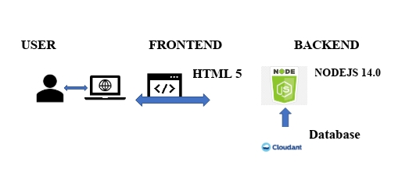
System Architecture

Slide 7
System Deployment Approach
Augmented reality (AR), virtual reality (VR), and mixed reality (MR) Hardware and software for video game development. eSports technology. Gaming hardware.
Game developers use programming languages, frameworks, libraries, patterns, servers, software, and other tools to develop game applications.
The game development stack integrates the code and the execution for game applications. Common game development stacks for game applications include Python, C#, .

Slide 8
Algorithm & Deployment
Game AI/heuristic algorithms are used in a wide variety of quite disparate fields inside a game.
The most obvious is in the control of any NPCs in the game, although “scripting” (decision tree) is currently the most common means of control.

Slide 9
Conclusion
By the above data we can say that action games on DC or playstation for that matter are the most popular and are the ones responsible for maximum sales all over the globe.
Also as these games are so abundant and popular(ranking wise), variation in the sales of one or two such games would not cause significant change in the overall sales.

Slide 10
References
Kaggle
https://www.kaggle.com/datasets
Wikipedia
https://en.wikipedia.org/wiki/Video_game

Slide 11
Future Scope
Video Game Market Outlook (2022-2032) [333 Pages Report] The video game market is anticipated to have a prodigious CAGR of 12.9% during the forecast period of 2022-2032. According to FMI, the video game market is expected to grow from US$ 195.65 billion in 2021 to US$ 743.21 billion by 2032.
The future of gaming looks bright, with the emergence of new technologies such as virtual reality and the increased prevalence of mobile gaming. Virtual reality (VR) has the potential to revolutionize the gaming industry by immersing players in a fully interactive and realistic digital world.

Slide 12
THANK YOU

